Slide 1
Senser Band
Project by :- ( 2nd year -- Pratigya Dhakal, Salipa Gurung, Alson Garbuja)
Guided by :- Jhalak Lamichane

Slide 2
CONTENTS
INTRODUCTION
OBJECTIVES
EQUIPMENTS
METHODOLOGY
FUTURE SCOPE
CONCLUSION

Slide 3
Introduction
Vision is the most important part of human physiology as 83% of human information being gets from the environment is via sight.Sensor Band is an innovative band designed for visually disabled people for improved navigation. We here propose an advanced sensor band that allows visually challenged people to navigate with ease using advanced technology. The Sensor Band is integrated with ultrasonic sensor along with GPS tracking system.

Slide 4
Objectives
UltraSonic sensor is used to detect the presences of object and calculate the distance between Band and the object.
GPS tracker for providing their current location
Warning through buzzer and vibration

Slide 5
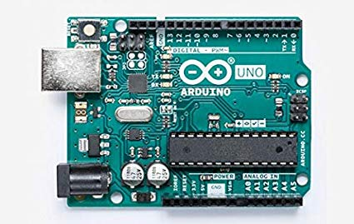
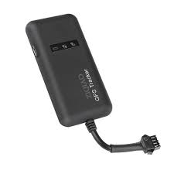
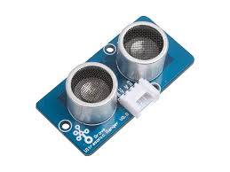
Equipments
Arduino UNO
5v Battery
UltraSonic Sensor
Vibrating Motor
Buzzer
GPS tracker
Wires (male-male*5, female-female*5)
LED
Switch (Push button)

Slide 6
Methodology
We propose a advance Sensor Band that allows visually challenged people to navigate with ease and safe along with the ambience of their location. Our Sensor Band is integrated with ultrasonic sensor and GPS tracking system. At first it uses ultrasonic sensor to detect the obstacles and passes the data to the Arduino board. The Arduino UNO then process the data and calculate if the object is close enough for user to be alerted, if the obstacle is close enough the buzzer and vibrator is used to alert them.
Our system also have another technology to provide them with their current location using the GPS tracking system, on the click of switch within Sensor Band.

Slide 7
5v Battery
UltraSonic Sensor
Arduino
Buzzer & Vibrator
LED
GPS tracker
Speaker
Switch

Slide 8
Conclusion
The main target of this project is to assist blind or visually impaired people to safely-move among obstacles, and other hurdles faced by them in their daily life. The solution developed is a user-friendly navigational aid for them. The advantage of the system lies in the fact that it can prove to be a very low cost solution to millions of blind people.
Thus it will help blind people when they are walking outside from their home, Besides that if any blind people get lost then his/her relative can also know about their location by using GPS system.

Slide 9
Future Scope
Increasing the number of sensor to implement another application like on-coming vehicle detection, Fire & Smoke detection, etc
Android application can be developed for further uses
Arduino can be replaced by upgraded Microcontroller or chip
High range ultraSonic sensor can be used
Can be made compact using VLSI technology(Very Large Scale Integration)

Slide 10

Gandaki College of engineering and Science
Lamachour-16, Pokhara
Email: gces@gces.edu.np
Phone-no: +977-61-440866

